Slide 1
Closeness Centrality and Centralisation

Slide 2
Closeness Centrality
The closeness centrality of a node is the average length of the shortest path between the node and all other nodes

Slide 3

Closeness Centrality
The closeness centrality of a node i is given by,
Where n is the number of nodes in a graph,
d(i,j) is the shortest distance to j from the node i

Slide 4
Closeness centrality
The node with the highest closeness centrality is the closest one to all other nodes

Slide 5
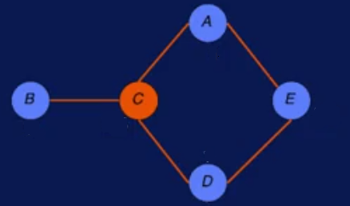
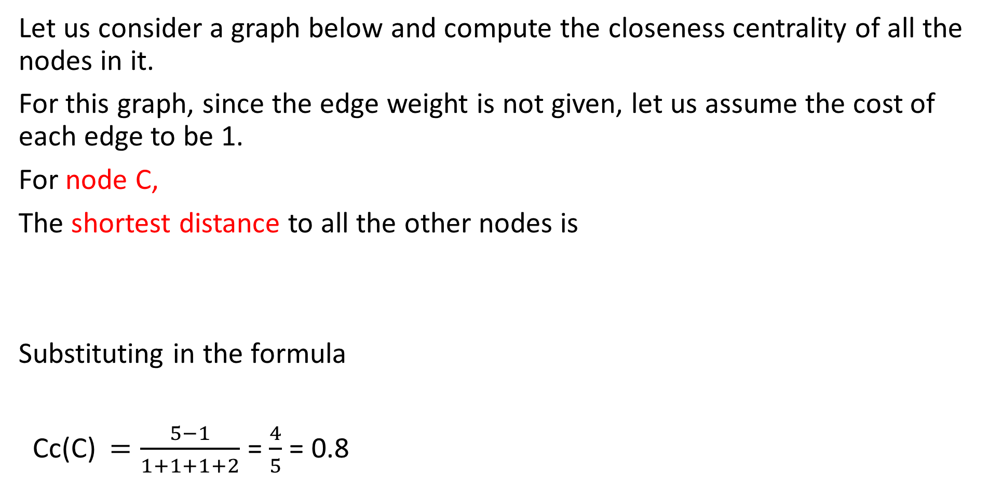
Example
Let us consider a graph below and compute the closeness centrality of all the nodes in it.
For this graph, since the edge weight is not given, let us assume the cost of each edge to be 1.
For node C,
The shortest distance to all the other nodes is
Substituting in the formula
Cc(C) $=\frac{5−1}{1+1+1+2}$ = $\frac{4}{5}$ = 0.8
A | B | D | E
1 | 1 | 1 | 2

Slide 6

For node A,
The shortest distance to all the other nodes is
Cc(A) $=\frac{5−1}{2+2+1+1}$ = $\frac{4}{6}$ = 0.67
B | D | C | E
2 | 2 | 1 | 1

Slide 7

For node B,
The shortest distance to all the other nodes is
Cc(B) $=\frac{5−1}{2+1+2+3}$ = $\frac{4}{8}$ = 0.5
A | C | D | E
2 | 1 | 2 | 3

Slide 8

For node D,
The shortest distance to all the other nodes is
Cc(D) $=\frac{5−1}{2+2+1+1}$ = $\frac{4}{6}$ = 0.67
A | B | C | E
2 | 2 | 1 | 1

Slide 9

For node E,
The shortest distance to all the other nodes is
Cc(E) $=\frac{5−1}{1+3+2+1}$ = $\frac{4}{7}$ = 0.57
A | B | C | D
1 | 3 | 2 | 1

Slide 10

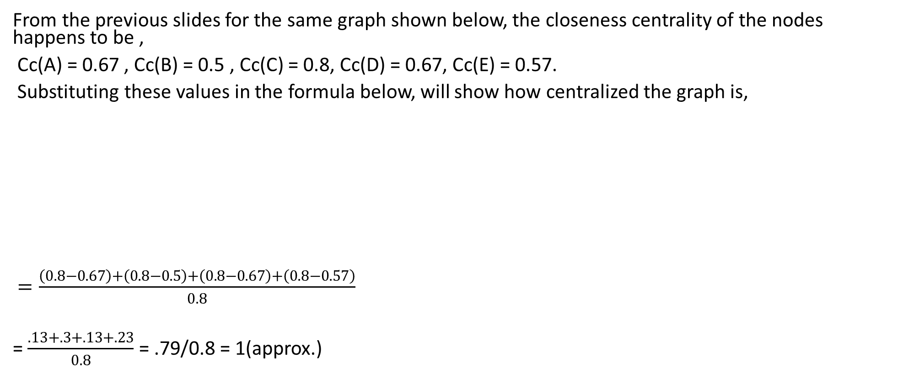
Centralization
From the previous slides for the same graph shown below, the closeness centrality of the nodes happens to be ,
Cc(A) = 0.67 , Cc(B) = 0.5 , Cc(C) = 0.8, Cc(D) = 0.67, Cc(E) = 0.57.
Substituting these values in the formula below, will show how centralized the graph is,
$=\frac{\left(0.8−0.67\right)+\left(0.8−0.5\right)+\left(0.8−0.67\right)+\left(0.8−0.57\right)}{0.8}$
= $\frac{.13+.3+.13+.23}{0.8}$ = .79/0.8 = 1(approx.)

